Slide 1
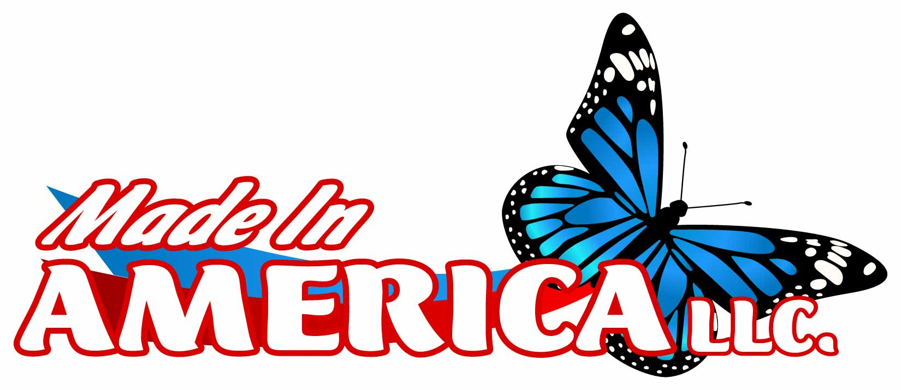
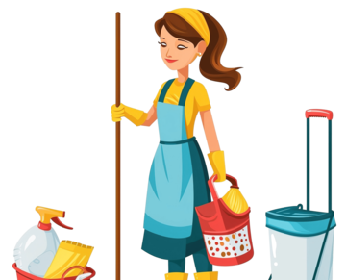
Made In America
A cleaning service company
Reliable Cleaning, Remarkable Results
Professional Residential & Commercial Cleaning Services

Slide 2
Who are we?
A cleaning service company that provides reliable, detailed, and eco-conscious cleaning services
Made In America was establish in 2022 in Tri-cities WA
Locally owned and operated by President Susana Hernandez
Honest hard working people that care
Offer services in Tri-Cities, Hermiston

Slide 3
SERVICES WE PROVIDE
Residential Cleaning:
Regular & Deep Cleaning
Move-in/Move-out Cleaning
Post-renovation Clean-up
Commercial Cleaning:
Office & Retail Cleaning
Airbnb & Vacation Rental Cleaning
Medical & Industrial Facilities
Free estimates in Tri-Cities

Slide 4


YOU WOULD BE VERY GLAD THAT YOU CHOSE MADE IN AMERICA BECAUSE…..
Trained & background-checked staff
Licensed & Insured
100% satisfaction guarantee
We do it right the first time
Transparent pricing
Use Eco-friendly and nontoxic supplies

Slide 5
What to expect from us

Slide 6
Pricing
Varies in pricing depending on what all needs to be done

Slide 7
Contact Us
Email: SHHOUSEKEEPINGWA@GMAIL.COM
Phone: 281 779 1772
509 851 9589

